Slide 1

Comparing to human-level performance
Improving your model
performance
deeplearning.ai

Slide 2
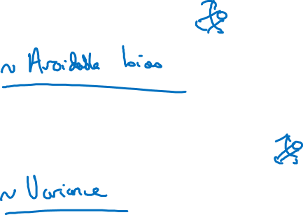
The two fundamental assumptions of supervised learning
1. You can fit the training set pretty well.
2. The training set performance generalizes pretty
well to the dev/test set.

Slide 3
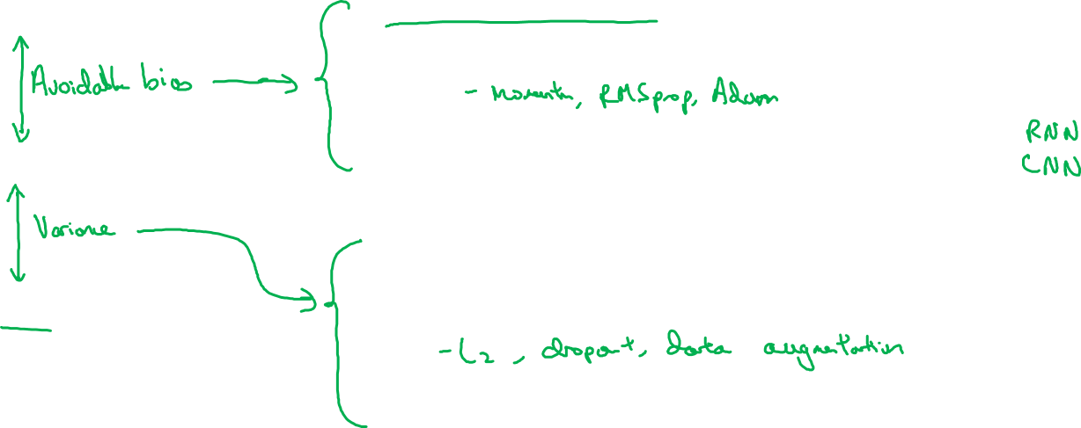
Reducing (avoidable) bias and variance
Human-level
Train bigger model
Train longer/better optimization algorithms
Training error
NN architecture/hyperparameters search
More data
Dev error
Regularization
NN architecture/hyperparameters search

